Slide 1
React Components

Slide 2
Components are like functions that return HTML elements.
Components are independent and reusable bits of code. They serve the same purpose as JavaScript functions, but work in isolation and return HTML.
Components come in two types, Class components and Function components

Slide 3
Class Component
A class component must include the extends React.Component statement. This statement creates an inheritance to React. Component, and gives your component access to React.Component's functions.
The component also requires a render() method, this method returns HTML.

Slide 4
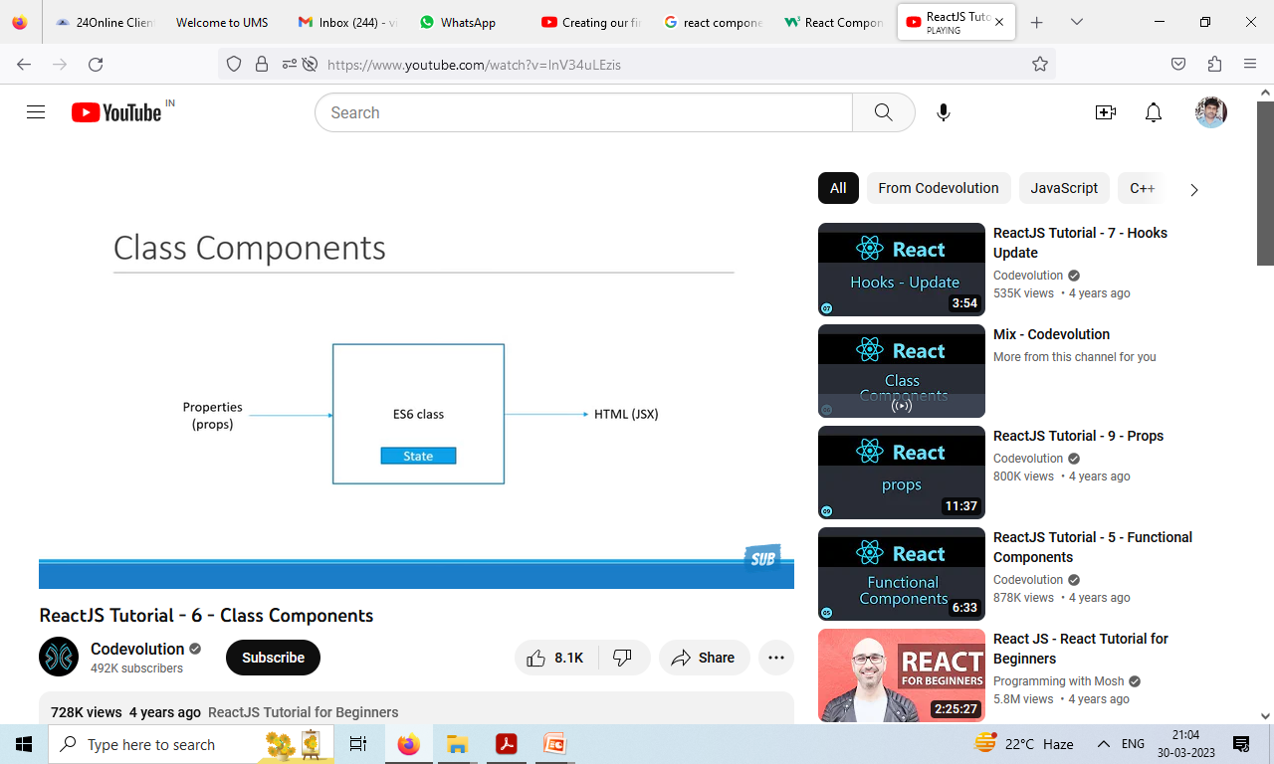

Slide 5
welcome.js
import React, {Component} from "react";
class welcome extends Component{
render()
{
return<h1> class component to be returned by render method </h1>
}
}
export default welcome.js

Slide 6
App.js
import logo from './logo.svg';
import './App.css';
import {welcome} from './welcome';
function App() {
return (
<div className="App">
<header className="App-header">
<img src={logo} className="App-logo" alt="logo" />
<p> testing the code and react </p>
<welcome />
</header>
</div>
);
}
export default App;

Slide 7
Function Component
A Function component also returns HTML, and behaves much the same way as a Class component, but Function components can be written using much less code, are easier to understand, and will be preferred in this tutorial.

Slide 8
Greet.js
import React from 'react'
function Greet()
{
return <h1> Hello functional component </h1>
}
export default Greet

Slide 9
App.js
import React from 'react';
import ReactDOM from 'react-dom/client';
import './App.css';
import Greet from './component/Greet';
class App extends Component
{
render() {
return (
<div className = "App">
<Greet />
</div>
);
}
}
export default App;

Slide 10
Props
Components can be passed as props, which stands for properties.
Props are like function arguments, and you send them into the component as attributes.

Slide 11
Use an attribute to pass a color to the Car component, and use it in the render() function:
function Car(props)
{
return <h2>I am a {props.color} Car!</h2>;
}
const root = ReactDOM.createRoot(document.getElementById('root'));
root.render(<Car color="red"/>);

Slide 12
Components in Components We can refer to components inside other components
Use the Car component inside the Garage component:
function Car()
{
return <h2>I am a Car!</h2>; }
function Garage()
{ return
(
<> <h1>Who lives in my Garage?</h1>
<Car /> </> );
}
const root = ReactDOM.createRoot(document.getElementById('root')); root.render(<Garage />);
Who lives in my Garage?
I am a Car!

Slide 13
Components in Files
React is all about re-using code, and it is recommended to split your components into separate files.
To do that, create a new file with a .js file extension and put the code inside it:
Note that the filename must start with an uppercase character.

Slide 14
"Car.js"
function Car()
{
return <h2>Hi, I am a Car!</h2>;
}
export default Car;

Slide 15
Now we import the "Car.js" file in the application, and we can use the Car component as if it was created here.
import React from 'react';
import ReactDOM from 'react-dom/client';
import Car from './Car.js';
const root = ReactDOM.createRoot(document.getElementById('root'));
root.render(<Car />);

Slide 16
DOM rendering
It is a platform and language independent interface standard that allows programs and scripts to dynamically access and update the content, structure, and style of a document.
When a web page loads, the browser builds the page’s DOM tree. In this way, we can change all HTML properties on the page, remove existing HTML elements and attributes, add new HTML elements and attributes, or change all CSS styles on the page with scripting languages ​​such as JavaScript.

Slide 17


Slide 18
What is the DOM Tree?
A DOM tree is a type of tree whose nodes represent the content of the HTML and XML document. Every HTML or XML document has a unique DOM tree representation. For example, let’s examine the following code:
<html> <head> <title>My document</title> </head> <body> <h1>Header</h1> <p>Paragraph</p> </body> </html>

Slide 19
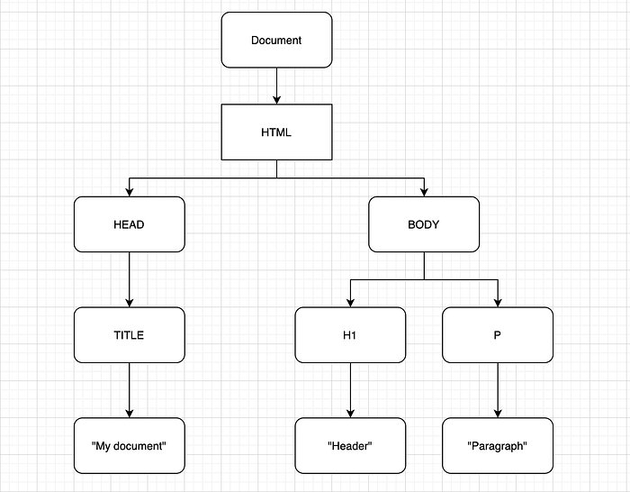
The DOM tree of the above code block is as follows:

Slide 20
How the Browser Renders HTML?
A web browser is a piece of software that downloads files from a remote server and displays them to you, allowing user interaction. The process of compiling the files downloaded from a remote server and showing them to the user is done by browser engines. If you are interested, you can examine different browser engines and comparisons.
Data is sent over the Internet as byte packets. The browser must convert these data bytes into a form it understands. Firstly, bytes are converted to HTML characters and then to Tokens. In the next step, Tokens are converted into nodes. Nodes are different objects with certain properties. After the nodes are created, the DOM tree is created.

Slide 21
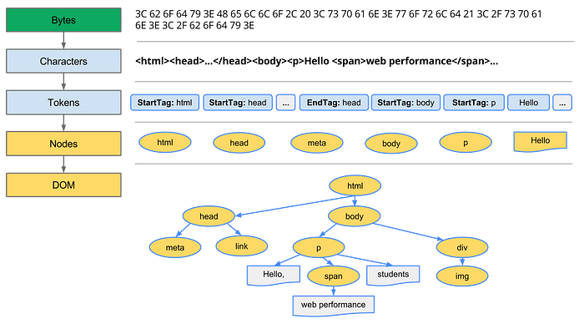

Slide 22
While creating the DOM tree, the “document” node is created first. Document is a node that represents the entire HTML document. The node that specifies an HTML tag is called “elements”. We can learn the type of any node in the DOM tree with “nodeType”. The NodeType property returns a number.
The DOM tree has been successfully created, but the browser needs information on how the elements will appear in order to render the page. It is the CSSOM’s responsibility to know how the elements of a page should appear.

Slide 23
What is the CSSOM?
While creating the DOM tree, a request is sent to the CSS link in the <head> and the CSS styles are returned as a result of this request. As with HTML tags, CSS information comes in bytes, and the CSS Object Model (CSSOM) is created by going through certain stages.

Slide 24
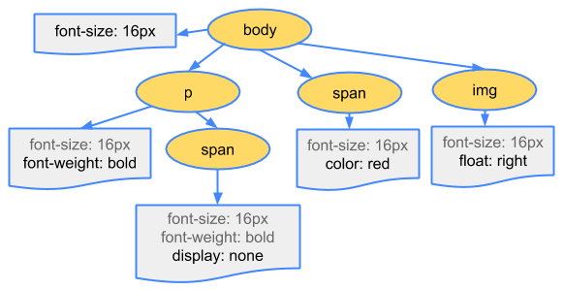
CSS bytes are converted to characters, then tokens and nodes; Finally, a tree structure known as the CSS Object Model or CSSOM for short, is created.

Slide 25
What is the Render Tree?
DOM and CSSOM tree structures are two independent structures. The DOM contains all the information about the relationships of the HTML element of the page, while the CSSOM contains the information about how to style the elements.

Slide 26
